Slide 1
Monitoring and dashboarding in ICP
Ingo Averdunk AVERDUNK@de.ibm.com
Raymond “Ray” Stoner rstoner@us.ibm.com

Slide 2
Special thanks
Ingo Averdunk
Richard Wilkins
Robert Barron
And my special guest:
Victor Harvard

Slide 3
This presentation is intended for an IBM internal audience only.

Slide 4
Objectives
After completing this lecture, you will be able to:
Understand the concepts of Cloud Service Management & Operations (CSMO).
Familiarity with the default monitoring and logging tools that come with ICP.
Basic knowledge of the possible enhancements to monitoring and logging.

Slide 5
Agenda
Introduction – CSMO, personas, roles
Levels of CSMO in ICP or what's “on the truck”
What if I’m already and IBM APM customer?
Ingo Averdunk , DE CSMO

Slide 6
What is Cloud Service Management & Operations
As defined in the IBM Architecture Center
https://www.ibm.com/devops/method/content/architecture/serviceManagementArchitecture
Cloud service management and operations refer to all the activities that an organization does to plan, design, deliver, operate, and control the IT and cloud services that it offers to customers.
Service management includes the operational aspects of your applications and services. After an application is pushed to production, it must be managed. Applications are monitored to ensure availability and performance according to service level agreements (SLAs) or service level objectives (SLOs).

Slide 7
Why its important
As customers adopt the cloud and new ways of managing and rapidly deploying their applications, Application Performance Management now more than ever is vital to the customers completive balance in their market place.
Poor application performance will drive customers away
A LOB and the associated enterprise are moving applications to cloud faster and faster its important to know how the application is performing against customer demand
The ability to rapidly respond and correct anomalies is impossible with out proper monitoring of the applications and the associated infrastructure and incident notification and management.
Performance Management data provides the ability to trend the application perfomace and understand it growth and seasonal patterns.
IT CAN SAVE YOU MONEY

Slide 8
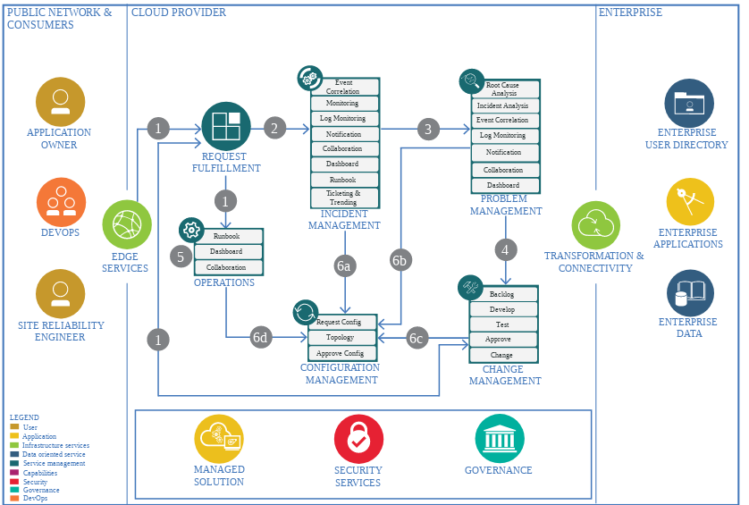
Cloud Service Management
CSMO Spine
Operations Transformation
Incident Management
Problem Management
Change Management
Dashboarding & Reporting
Operations
Compliance
Build to Manage
Release Management
Configuration Management
Service Continuity
Performance & Capacity Management
Service Level Management
Financial Management
Business Performance
Continued Service Improvement
For more information on CSMO please see the Architecture Center https://www.ibm.com/devops/method/content/architecture/serviceManagementArchitecture

Slide 9


CSMO Incident Management Tool Chain
Dashboards & Reporting
Runbooks
Monitoring
Event
Management
Logging
Notification
Collaboration
ICP
Ticketing & Trending
Monitor
Analyze
Plan
Execute
https://www.ibm.com/devops/method/content/architecture/incidentManagementDomain/overview

Slide 10
This Session only covers part of the toolchain
Dashboards & Reporting
Metrics, Logs, Events
Runbooks
Monitoring
Event
Management
Logging
Notification
Collaboration
ICP
Ticketing & Trending
Monitor
Analyze
Plan
Execute

Slide 11
Levels of CSMO in ICP
Lvl 0 – Out of the box:
Builtin Dashboard for metrics
Builtin Log console
Lvl 1 – Default monitoring workloads
Deploy Prometheus for metrics
Deploy ELK for Logging
Lvl 2 – External Monitoring and Logging
External APM monitors metrics and thresholds
ELK stacks forwards to external ELK stack
Lvl 3 – Integration with CSMO toolchain
Forward events to NOI
Forward Log events to NOI

Slide 12

This week we have been focused on the personas below
Primary Role
Todd has confidence in the private cloud platform. He knows corporate data is secure and in compliance with government regulations and/or industry standards. He has control and visibility of the running applications and can quickly update workloads and the underlying platform using continuous delivery techniques, without requiring downtime. Application data is automatically managed for backup, recovery, and disaster failover into alternate locations.
Todd
Operations / Admin
Responsible for infrastructure, security,
and management of the environment
Todd receives incident alerts
He Ensures monitoring is in place for the application components
User, Buyer
Secondary Role
Jane can immediately leverage CI/CD to rapidly develop, test and deliver her applications on the IBM cloud platform. She has a core set of services she needs, including data and application runtime services, with prescriptive guidance for moving heritage workloads to the cloud and/or creating new cloud native applications. She can also safely integrate off-premises cloud services into her application.
Jane
Enterprise Developer
Responsible for modernizing existing applications
and Creating new Cloud Native Workloads
Jane leverages build to manage so that Todd can deploy “health” tests against the APIs.
She is concerned with her applications performance and trends
User, Buyer
Influencers:
Lines of business / application owners, Cloud / Application architects, Security teams, Regulatory and compliance owners

Slide 13
CSMO Roles in Service Management for ICP
First Responder
Incident Commander
SME / Developer
Site Reliability Engineer (SRE)
Cloud Operator
Receives the alerts via collaboration tooling
Research to determine if the problem real
Reviews known/existing issues to determine if outage is a known issue
Tries and resolves the issue via the prescribed runbooks
Gain concurrence from the customer it is resolved
If not solved, assignment to an incident owner occurs
Collaborates with Customer if more details are needed for problem resolution
Receives the incident information
Collaborates with SMEs to restore service
Updates key stakeholders with status and expected resolution times
Interfaces and works with vendors to isolate problems and drive resolution
Collaborates with 1st responder if more information is needed from customer
Brings the incident to closure
Opens Problem ticket for analysis and acceptance as a Problem
Investigates the problem in Monitoring tools for more details.
Inspects logs
Tests and verifies issues
Recommends fixes if missing instruction for 1st Responder / Fixes the problem
Proposes changes if updates needed, Requests Change Management
Implements change
Provides data for SRE review
Ensuring a Durable Focus on Engineering
Full access to and authority to fix, extend, and scale the code to keep it working and harden it against threats.
Pursuing Maximum Change Velocity Without Violating a Service’s SLO
Focused on reliability, scalability and development of the Cloud infrastructure
Eliminate or reduce the losses through root cause analysis
Identifying Trends
The Cloud Operator takes operational responsibility for the support of products & services running at global scale in a hybrid cloud environment where a highly automated service management approach is not yet possible.
The Operator will support the SRE function with identification and removal of “Toil” (repeative manual labor which does not add real value)
Spends approximately 20% of the working time in supporting engineering projects (Improvements)
First Responder are not the typical Level-1 support. Their responsibility and skill is rather a Level 2.5 support
Fundamentally, it’s what happens when you ask a software engineer to design an operations function.
Notes:
A site reliability engineer (SRE) will ideally spend up to 50% of their time doing "ops" related work such as issues, on-call, and manual intervention. Since the software system that an SRE oversees is expected to be highly automatic and self-healing, the SRE should spend the other 50% of their time on development tasks such as new features, scaling or automation. The ideal SRE candidate is a coder who also has operational and systems knowledge and likes to whittle down complex tasks.
Responsible for availability, latency, performance, efficiency, change management, monitoring, emergency response, and demand forecasting and capacity planning

Slide 14
Today’s application landscape
CSMO
Heritage
Cloud native
Infrastructure
Hybrid

Slide 15
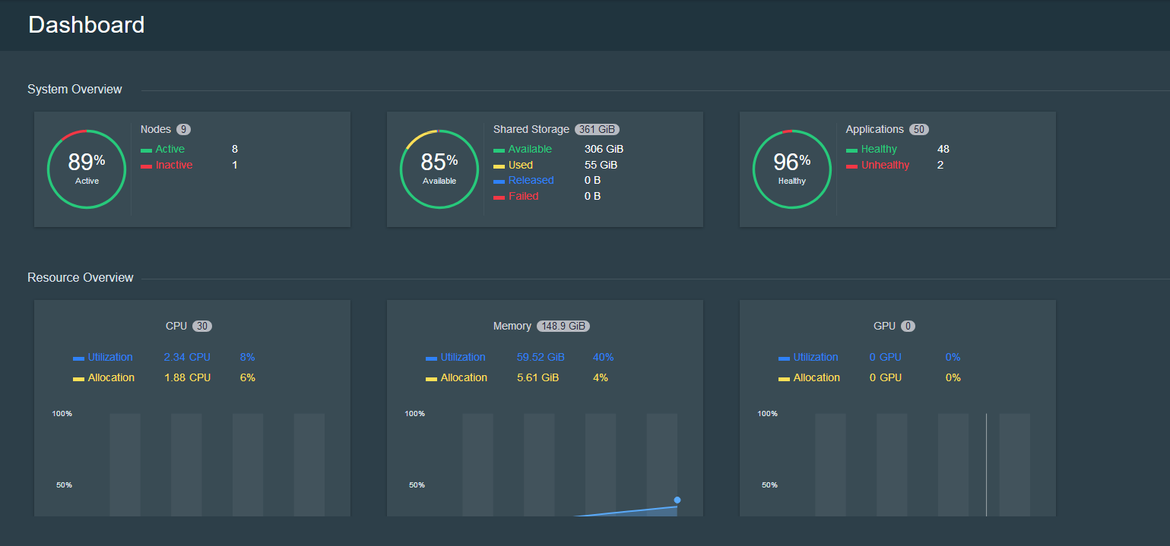
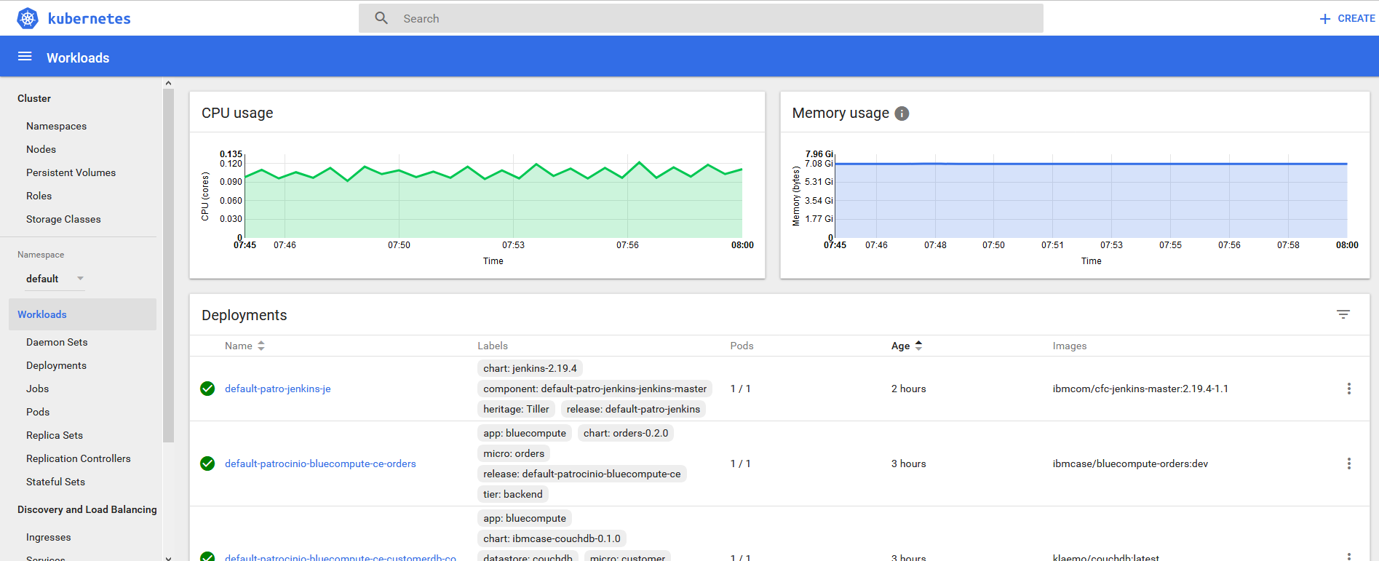
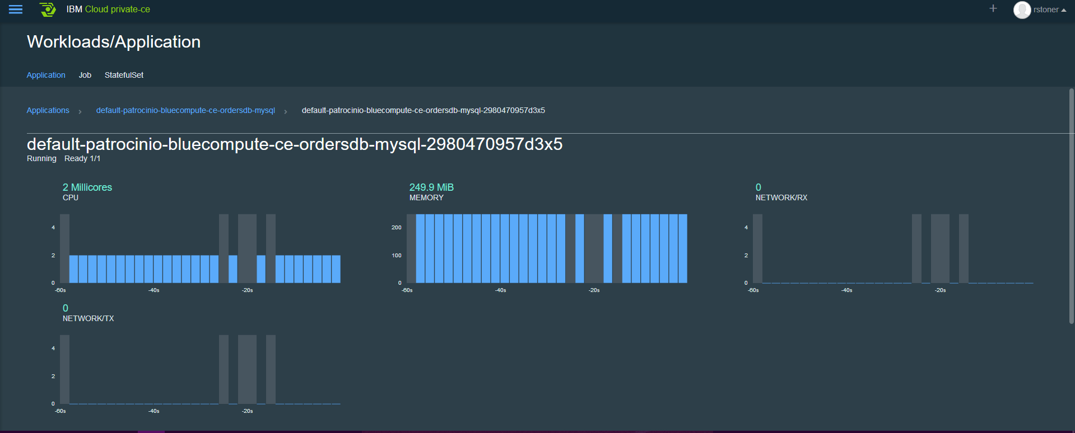
Monitoring an IBM Cloud Private Deployment (level 0)
Within IBM Cloud Private there are several ways to view high level Key Performance Indicators
The ICP dashboard shows a high level overview of resource usage and status.
The Kubernetes Dashboard shows
cpu and memory consumption of
the full cluster and deployments
Within an application you can view performance of the pod.
All well and good but you can only look and “not touch”. There are APIs available.
We need to be able monitor and alert on Out of Bounds conditions for the applications and their infrastructure.

Slide 16
What is the base level of Monitoring/Logging in ICP? (Level 1)
In the October release, the ICP infrastructure and the two types of workloads will be monitored.
The ICP dashboard shows the status, metrics and log entries for all the workloads & Infrastructure.
An ELK stack collects logs from all the workloads & Infrastructure. Multiple ELK stacks are possible (but each log can only reside in one stack)
A Prometheus stack collects logs from the Kubernetes workload
Customizable Grafana and Kibana dashboards are available for use
Prometheus can send alerts to external system (email, webhooks)
Alerts
Extendable Dashboards and Alerts (Grafana/Kibana)
5
4
Default Dashboards
1
Prometheus
Kubernetes
Cloud Foundry
ELK Stack
3
2
Heapster
Hosting Infrastructure (Virtual servers)

Slide 17
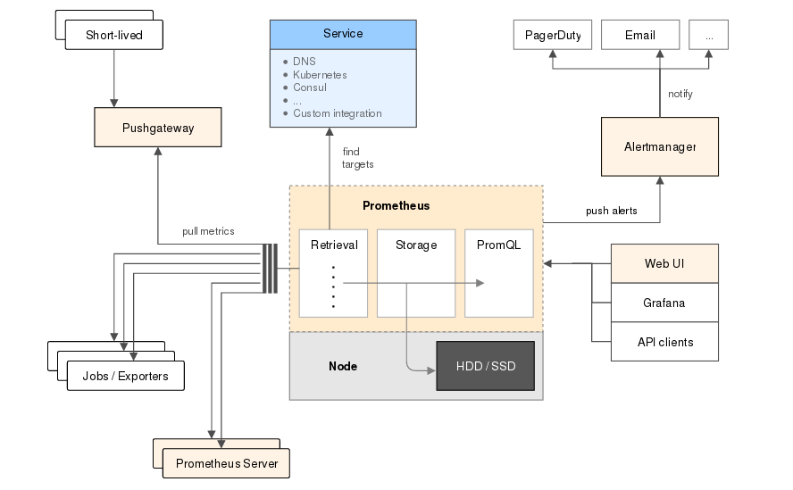
Prometheus
Prometheus is a Cloud Native Computing Foundation (CNCF) project, is a systems and service monitoring system. It collects metrics from configured targets at given intervals, evaluates rule expressions, displays the results, and can trigger alerts if some condition is observed to be true. https://prometheus.io/
Prometheus has several components for Time Series Data Collection, an Alert Manager and the Prometheus Server which scrapes and stores the data.
Prometheus will be deployed via a Helm Chart into ICP.

Slide 18
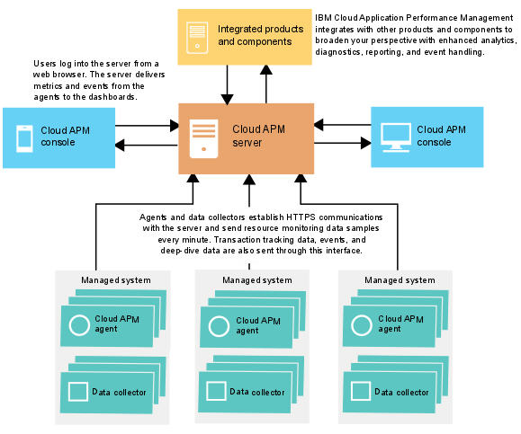
IBM APM v8 (level 1+2)
IBM APM is a comprehensive solution that helps you manage the performance and availability of applications that are deployed on premises (private), in a public cloud, or as a hybrid combination. This solution provides you with visibility, control, and automation of your applications, ensuring optimal performance and efficient use of resources.
You can reduce and prevent outages and slowdowns around the clock in a hybrid application world as Cloud APM assists you in moving from identifying performance issues to isolating where the problem is occurring and diagnosing issues before your business is impacted.

Slide 19
IBM APM and Prometheus Comparison Chart
BOX Note

Slide 20
Grafana
Grafana is an open source metric analytics & visualization suite. It is most commonly used for visualizing time series data for infrastructure and application analytics but many use it in other domains including industrial sensors, home automation, weather, and process control.
https://grafana.com/grafana
While Prometheus has limited dashboarding capabilities of its own, regular display of metrics will be done using Grafana dashboards.
Prometheus and the Grafana Dashboards are installed togethers as applications into ICP using Helm charts.

Slide 21
ELK stack or Elasticsearch Stack
The Elasticsearch stack (previously known as the ELK Stack) is a Log Management system which is composed of 3 layers:
Kibana is the extensible user interface for configuring and managing all aspects of the Elastic Stack.
Elasticsearch is a distributed, JSON-based search and analytics engine designed for horizontal scalability, maximum reliability, and easy management.
Logstash is a dynamic data collection pipeline with an extensible plugin ecosystem and strong Elasticsearch synergy.
Beats is a platform for lightweight shippers that send data from edge machines to Logstash and Elasticsearch.
Elasticseach is packaged as a series of Helm charts and are deployed automatically when ICP is installed (can be customized and/or opted-out of)

Slide 22
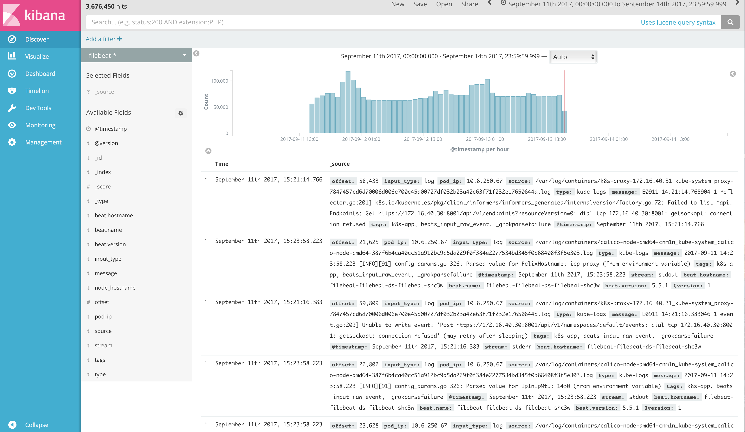
What are the advanced Logging capabilities for ICP? (Level 3)
In the October release, you will be able to forward logs to an external repository so that customers can consume logs in their own existing log management system.
Logs cannot be forwarded to multiple repositories.
Post-GA, a Kafka bus is planned to be added to the logging architecture which will allow subscriptions to logs and publication to multiple repositories.
External ELK / Splunk
/
Log Analysis
Kubernetes
Cloud Foundry
ELK/Logstash Stack
Istio
Heapster
Hosting Infrastructure (Virtual servers)

Slide 23
What are the advanced CSMO toolchain capabilities for ICP? (Level 3)
NOI Probes/Observers
NOI Event Management
NOI probes and observers collect events from multiple data sources within Icp including Kubernetes, Prometheus & DevOps monitoring? (waiting for Randy session)
APM monitors ICP (both workloads and Infrastructure) and forwards events to NOI
NOI Event Management layer performs de-duplication, correlation, grouping, etc…
IBM APM
Prometheus
Kubernetes
Cloud Foundry
ELK Stack
Heapster
Hosting Infrastructure (Virtual servers)

Slide 24
This Session only covers part of the toolchain
Dashboards & Reporting
Metrics, Logs, Events
Runbooks
Monitoring
Event
Management
Logging
Notification
Collaboration
ICP
Ticketing & Trending
Monitor
Analyze
Plan
Execute

Slide 25
The answer is not always in metric collection (Level 3)
Build to manage
Generate “health” events from within your application
Testable APIs
Synthetic Transactions
User experience
Coverage for components outside of your application

Slide 26
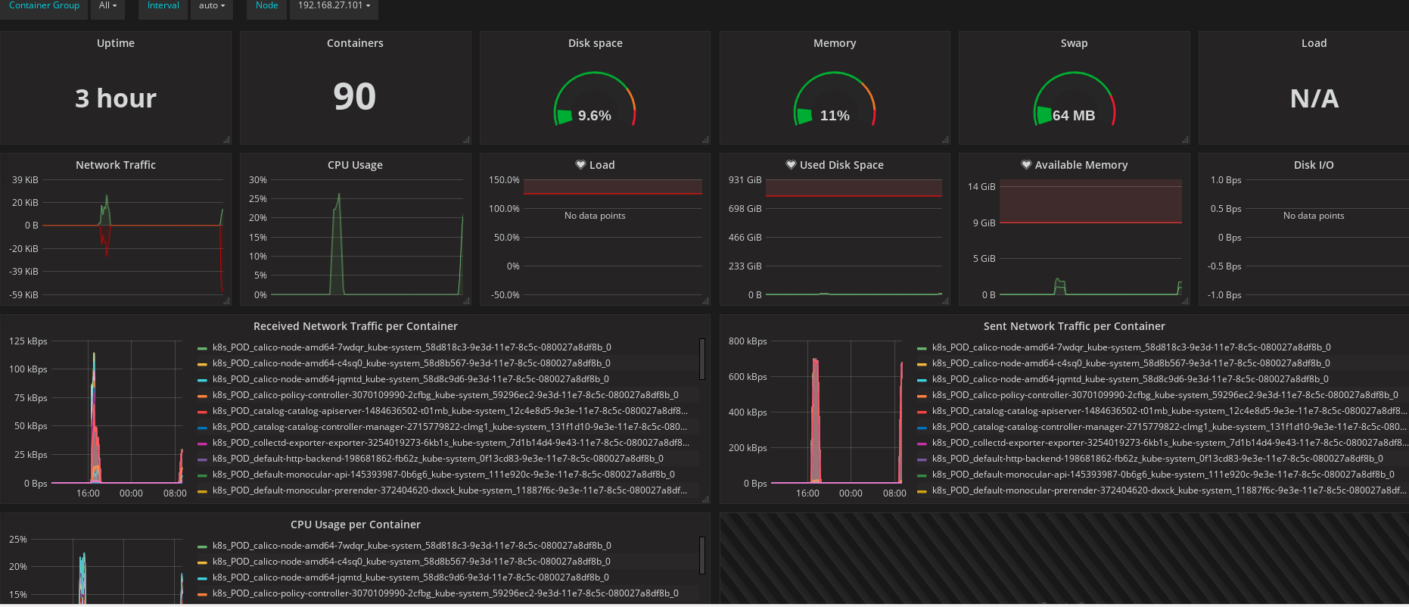
Custom Dashboards with Grafana
Pre-built dashboards are available here https://grafana.com/dashboards and can be imported to your Grafana application – the pre-built dashboards may require some “adjusting: for your environemtn.

Slide 27
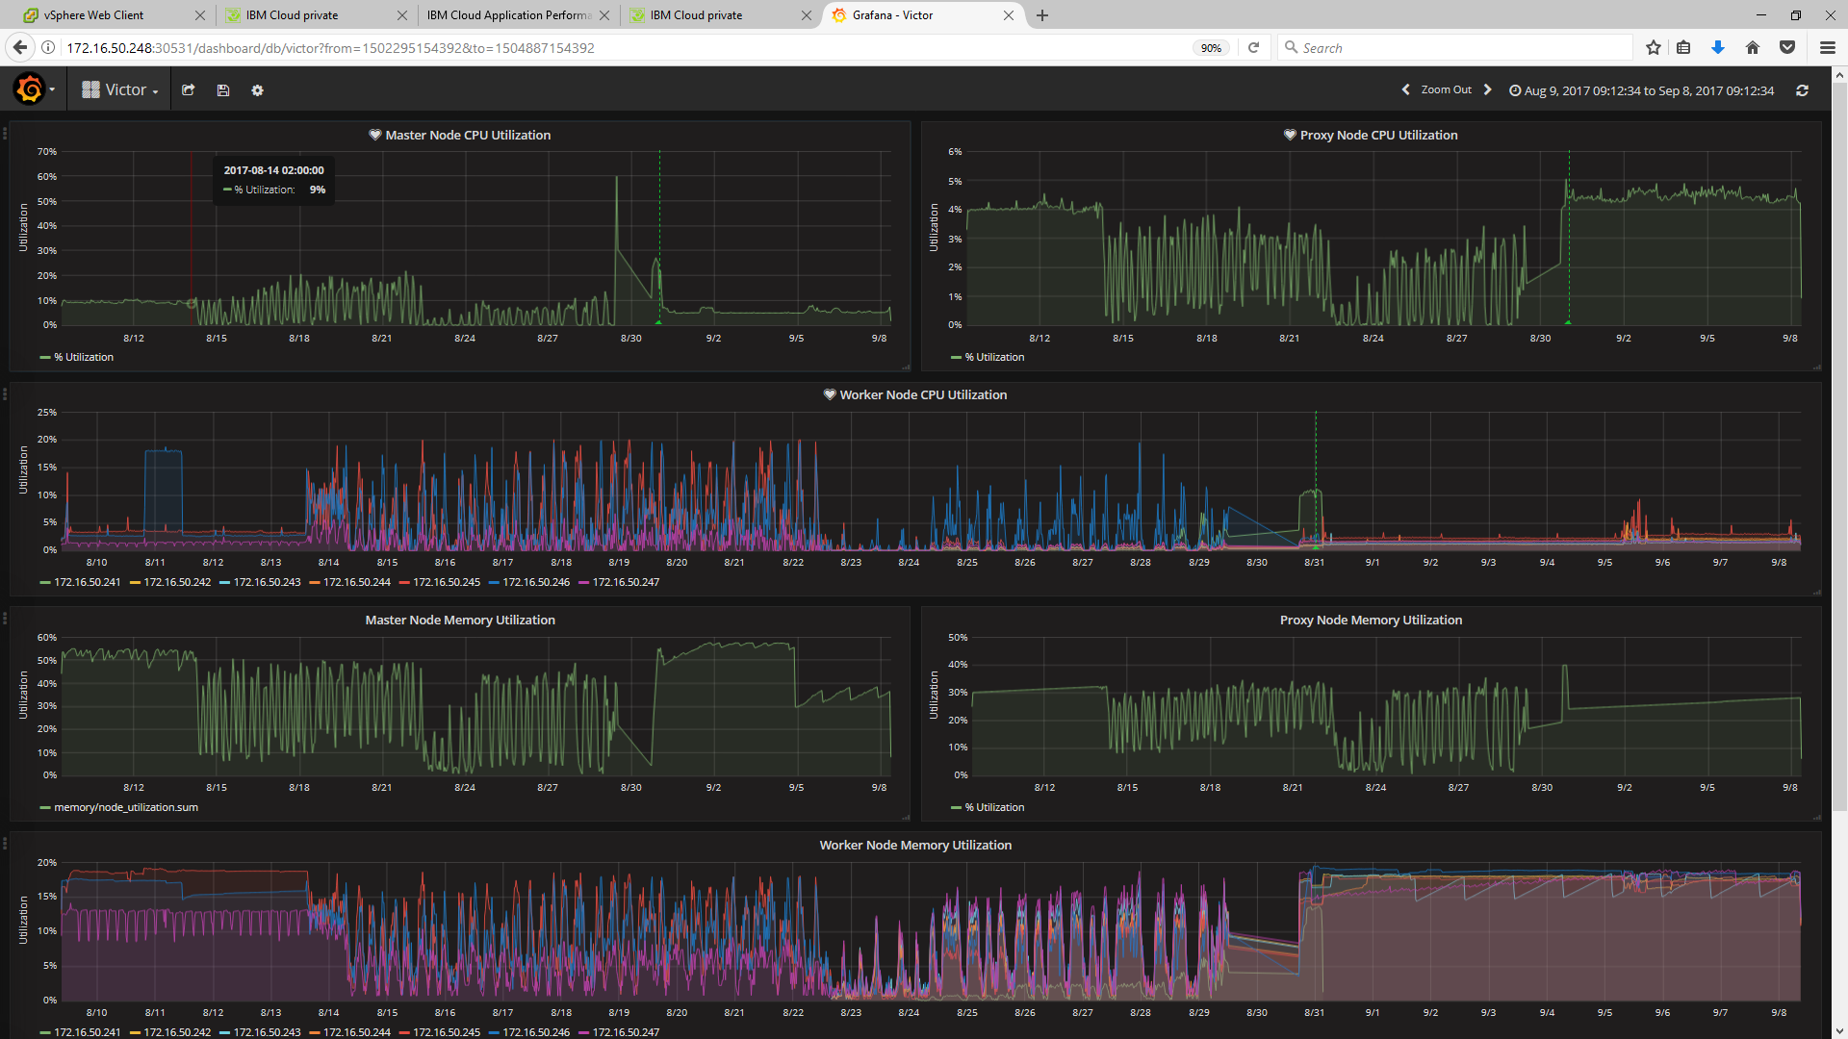
Custom Dashboards with Grafana
Victor, who is our Sight Reliability Engineer for CAMSE has built a custom dashboard for the ICP workload. Please see http://docs.grafana.org/guides/getting_started/ where you can quickly learn how to build custom dashboards.

Slide 28
IBM Cloud Private - CSMO Full spectrum coverage
Limited CSMO discussion
Plan
Platform , Technology and Use case agnostic
CSMO workshop
CSMO solution Implementation
ICP Plan and Prepare
Innovate
5 days
Prep for production
Develop/Deploy/Test
IBM Design Thinking Workshop
Create architecture and implementation plan based on use case
ICP Architectural Consultancy
ICP MVP Build-up for Apps and Ops
5 days
Get started
5 days
Variable weeks
Define business hypotheses and MVP scope
Solution Initiation Workshop
Plan client’s journey to production private cloud
Deploy first use case on IBM Cloud Private
10 days
Limited CSMO workshop using out of box configuration for CSMO components
Prepare the client environment for IBM Cloud Private

Slide 29

Cloud Service Management and Operations
Ingo Averdunk
Distinguished Engineer, IBM Cloud
September 21, 2017

Slide 30

Operations Transformation – Organizational Change
Traditional
Enterprise IT
Co-exist
Large Enterprise
Moving to Cloud
Small
Startup
Enterprise DevOps teams – delivering Microservices as full-stack deployments. Design tor resiliency, testing, QA.
Full Stack DevOps Team
Dev – app development, deploy, test…(note: QA team omitted to keep simple)
join
Ops – Services & middleware:
request driven provisioning,
configuration, patch..
Site Reliability Engineers / Environment Ops - Centralized policy, governance, audit.
Ensure org compliance policy, interface with cloud provider, First Responders, define acceptance criteria for new Microservices, and automated tests, audits, triage.
split
Ops – infrastructure: Procurement, provisioning, OS patch, etc.
Third party cloud provider (ex: IBM)
Third party cloud provider (ex: IBM)
Application
Services / Middleware
DevOps personas need a view of their project
SRE / Environment Ops personas need a view across multiple DevOps teams
Traditional IT Ops needs view across both traditional and cloud environments
Infrastructure

Slide 31
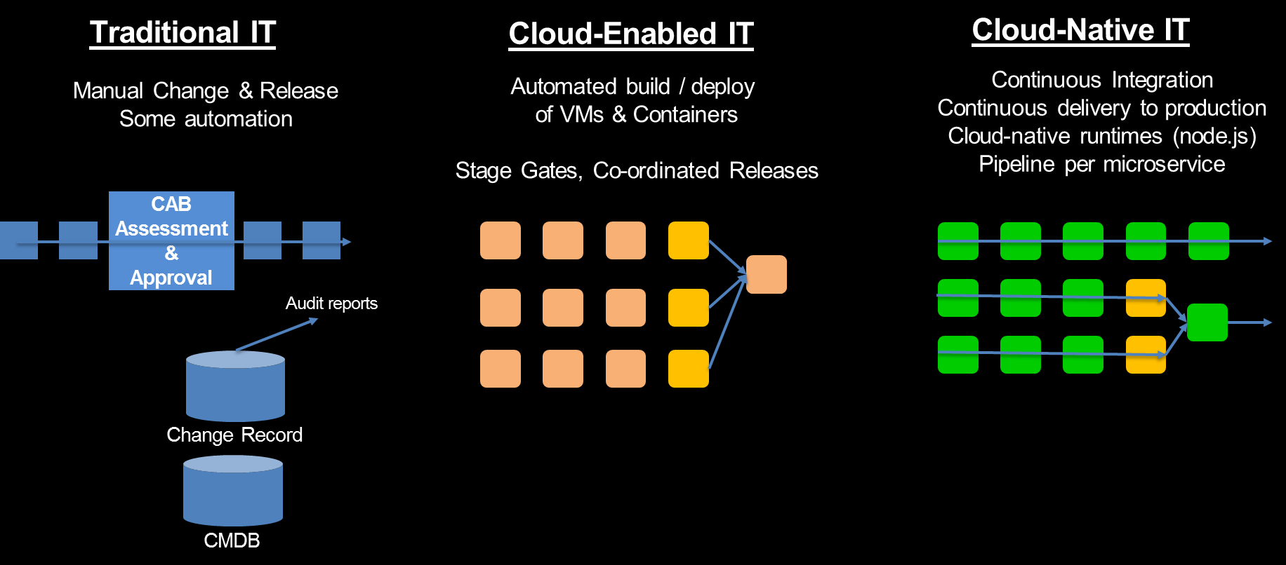
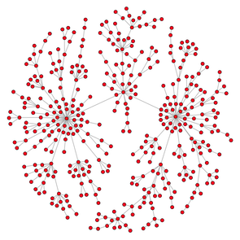
Change Management – Processes Change
Topology / Relationship Graph to Identify the “blast radius” of a configuration change.
Notes:
Topology & Relationships to identify the blast radius of a configuration change.

Slide 32
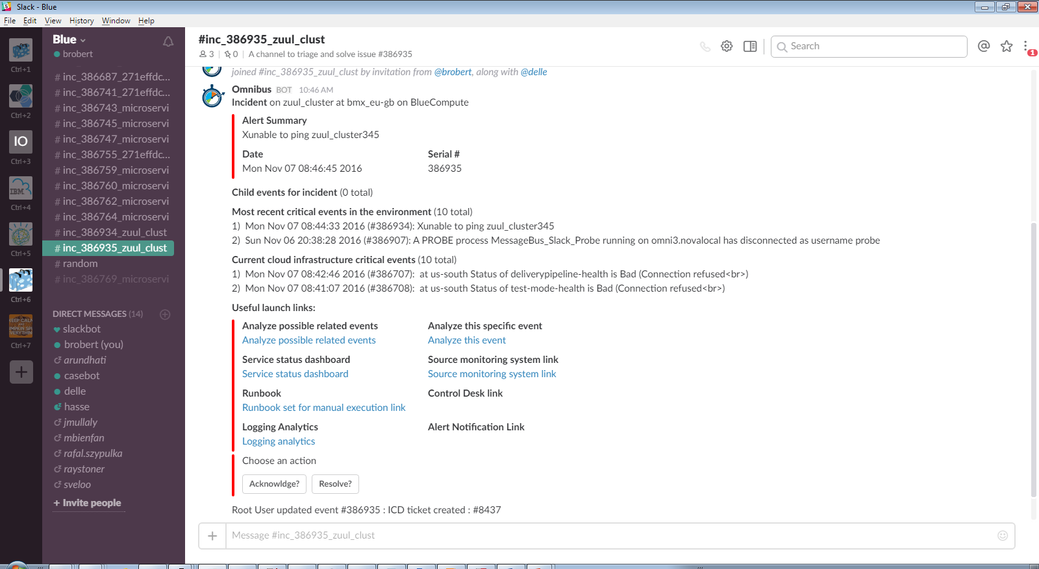
Incident Management ChatOps – Tools Change Rapid restoration of service through collaboration
Instant Collaboration
between SMEs …
Various Operations roles
Developers
Vendor / Provider
… and between Humans and Applications (through BOTs)
noi pull - retrieve the event from NOI noi ack - acknowledge the event noi deack – de-acknowledge the event noi ticket - open an ICD ticket for the event noi ans send - open an ANS alarm for the event noi journal - add a journal entry to the event noi resolve - resolve event (set severity to 0) noi critical - re-raise event (set severity to 5) noi sev # - set the severity of the event to # noi rba - retrieve the Runbook associated with the event noi list - show the latest events in the ObjectServer

Slide 33
Operations Transformation – Relationship of CSMO and DevOps
ITIL ?
NoOps ?
SRE
aaS
DevOps
Development
IT Operations
EnvOps
Cloud Service Management and Operations (CSMO)
DevOps
Environment Ops
Service Management,
ITIL, IT4IT, ZeroOutage
Site Reliability
Engineering

Slide 34
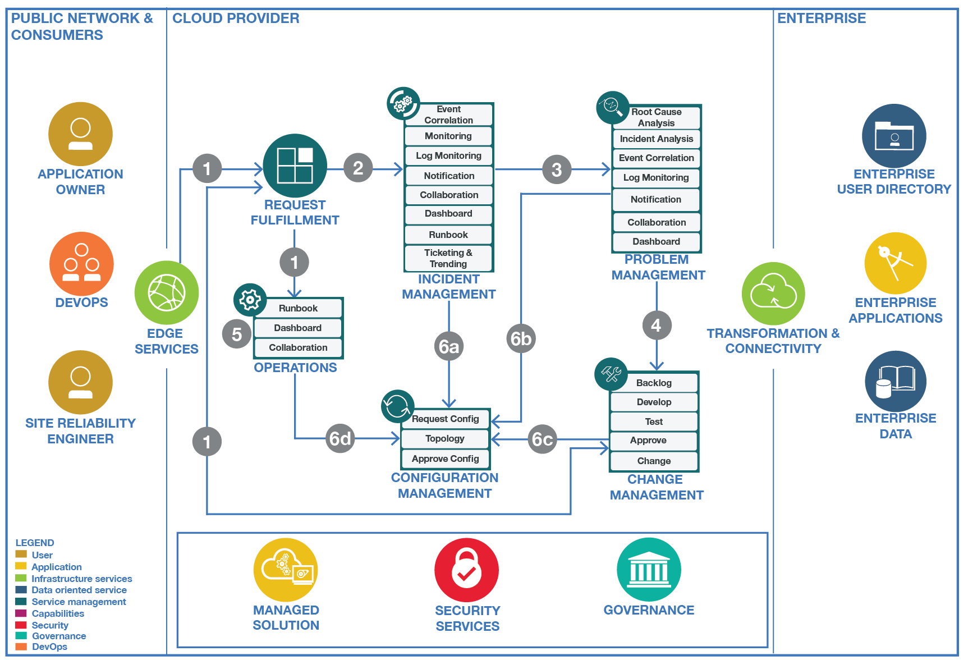
Cloud Service Management and Operation
Operations Transformation
Cloud Service Management and Operations refers to the entirety of activities – organized in persona, processes, and tools – that are performed by an organization to plan, design, deliver, operate and control IT and Cloud services offered to customers..
Assure Availability and Performance of applications running on the IBM Cloud platform, given the target SLA of 99.99% availability for applications
Reduce mean-time-to-repair to restore service as quickly as possible
Managing and controlling operational risks and threats
Incident Management
Problem Management
Change Management
Dashboarding & Reporting
Operations
Compliance
Build to Manage
Release Management
Configuration Management
Service Continuity
Performance & Capacity Management
Service Level Management
Financial Management
Business Performance
Continued Service Improvement

Slide 35
Cloud Service Management and Operation

Slide 36
Build To Manage – How to build manageable applications
Operations Transformation
As Development and Operations come closer together, new practices arise to better enable operations for cloud-based applications.
Shift Left: Build manageable applications / micro-services
Practices Include
HealthCheck API
Deployment Correlation
Topology Information
Test Cases and Scripts
Runbooks
Incident Management
Problem Management
Change Management
Log Format and Catalog
Distributed Tracing
Event Format and Catalog
Monitoring Configuration
First Failure Data Capture
Dashboarding & Reporting
Operations
Compliance
Build to Manage
manageability
management
Release Management
Health API
Configuration Management
Service Continuity
Runbook
Performance & Capacity Management
Events
Service Level Management
Logs
Financial Management
Application / Micro Service
(Managed entity)
Manageability defines how managed entities communicate with management functions
Management Tool
Business Performance
Management System
Continued Service Improvement
Application-specific Management Instrumentation
Component of the Management Stack

Slide 37
Cloud Service Management and Operations Service Offerings
The Cloud and Service Management Bluemix Garage
The IBM Cloud Garage CSMO offering helps enterprise clients adopt the right IT Operations practice for Cloud by identifying the organizational roles, processes, skills and tools necessary for optimal Service Management on Bluemix.
RACI for Cloud Services
Customers that are starting their journey to the cloud need to understand how best to provide Hybrid Cloud IT Management and the roles and responsibilities to enable the key support processes. IBM will provide a RACI (Responsible, Accountable, Consulted, Informed) matrix to clarify these for cloud delivery.
ChatOps – Transformation through Collaboration
Enable better team communications and increase efficient by enabling IT teams to collaborate and perform daily actions from a chatroom in real time. ChatOps connects people, bots, and tools, making information readily available and creating an easier workflow.
Build to Manage Service Offerings
As organisations move into the world of Cloud where microservices and continuous deployment is becoming more of the norm, clients need guidance and assistance to understand how their DevOps teams can implement and deploy applications and services that are reliable, performant , manageable and production ready.

Slide 38
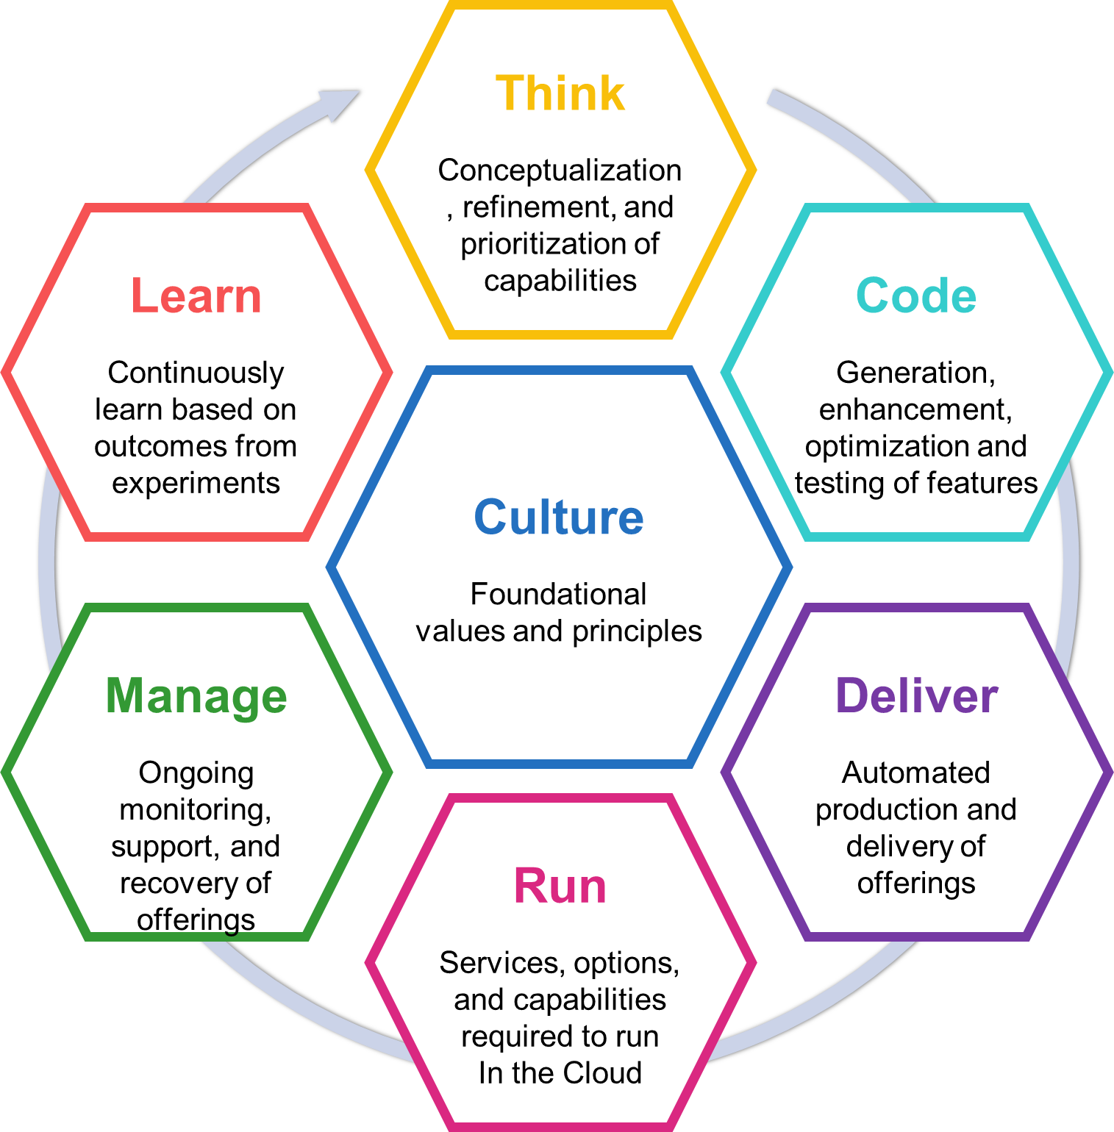
Cloud Service Management and Operations offering in the Bluemix Garage
The Bluemix Garage methodology drives transformational change using design thinking.
Deliver Operations for New Bluemix Development Culture
Harden Applications for Production Availability
Increase Service Management Efficiency
The CSMO Offering addresses the specific needs of the Operational side, just like the Bluemix Garage does for the Development side. Plus, we will enable cross-fertilization and integration between these offerings.
Visit : Overview, live showcases, dialog and success stories
Workshop : Uses design thinking to define personas, needs and transformational needs
MVP : Assist and partner to develop a working solution that begins the transformation
Transformation : Provide leadership and guidance in extending the MVP in transforming operational capabilities and processes
Half day
2-5 days
4-12 weeks
12+ weeks

Slide 39
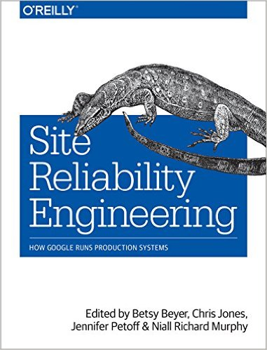
Cloud Service Management and Operation – References
Details of our work is documented in our Blog http://ibm.biz/csmo_blog. We try to keep it current and do regular updates through posts.
Specifically this article https://apps.na.collabserv.com/blogs/ca5e7833-78b8-481c-8a14-ba70b22a20ce/entry/Collateral_generated_by_CASE?lang=en_us links to additional collateral posted IBM internal
The architecture is published on the IBM Cloud Architecture Center at http://ibm.biz/csmo_arch
We manage an application "BlueCompute" to apply our CASE activities against. This is all documented on GitHub
Masterhead is here https://github.com/ibm-cloud-architecture/refarch-cloudnative
CSMO activities: https://github.com/ibm-cloud-architecture/refarch-cloudnative-csmo and more specifically https://github.com/ibm-cloud-architecture/refarch-cloudnative-csmo/blob/master/doc/Incident_Management_Implementation.md
This is now progressing towards other typologies, see https://apps.na.collabserv.com/blogs/ca5e7833-78b8-481c-8a14-ba70b22a20ce/entry/What_exactly_is_COLOR_Compute?lang=en_us for a description
Spine Presentation describing the dimensions of Cloud Service Management and Operations: http://ibm.biz/csmo_spine
These presentation decks that may be useful
CSMO Webinar: https://ibm.box.com/s/mjxdoj97jha3tjnpg76efc9j4sz105gs
Next Generation IT Operations https://ibm.box.com/s/he6ivminf8aq7ip1cyiukjtdd4ddr82b
Session on Cloud Service Management and Operations - (Cloud RA Series): https://ibm.6connex.com/event/BlueprintTalks/en-us/contents/61794/share?rid=home&nid=194368
Specific to GTS, you may also find the RACI engagement at Hertz interesting: https://apps.na.collabserv.com/blogs/ca5e7833-78b8-481c-8a14-ba70b22a20ce/entry/The_race_of_RACI?lang=en_us . From there, we have distilled a more generic RACI document, highlighting roles & responsibilities https://ibm.box.com/s/xkoxxjwgdjh5me9qpdqiubb88og0i6z1
There is a Garage Design Thinking workshop for Cloud Service Management, following Design Thinking & Garage methodology to start the transformation: http://ibm.biz/csmo_garage (BG126 in SODA)

Slide 40
What’s next or Post GA
Cloud Service Management and Operations will produce How To guides for advanced Application Performance Monitoring
Best practices to be published as they are realized
Integration of ICP in the Enterprise with Integrated Grafana Dashboards and north-bound integrations (webhooks)

Slide 41
Backup slides

Slide 42
What are the advanced Monitoring capabilities for ICP? (Level 3)
Grafana Dashboards
Default Dashboards
5
4
IBM APM
Grafana Dashboards
1
5
Prometheus
Kubernetes
Cloud Foundry
TBD – waiting for session with Randy George to discuss DevOps monitoring
3
Data collector
Agent?
2
Container
Heapster
Hosting Infrastructure (Virtual servers)
Agent
3

Slide 43
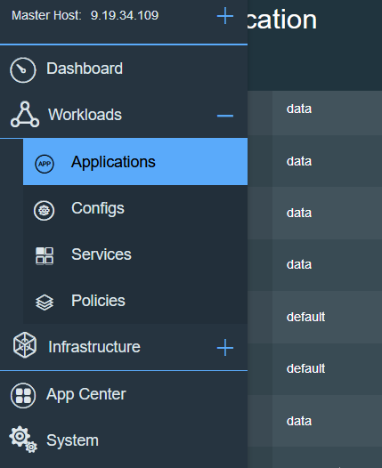
Prometheus Demo
Once logged into the ICP deployment launch the Prometheus Server by clicking on the Applications menu
and scroll down to the Prometheus sever and select it:

Slide 44
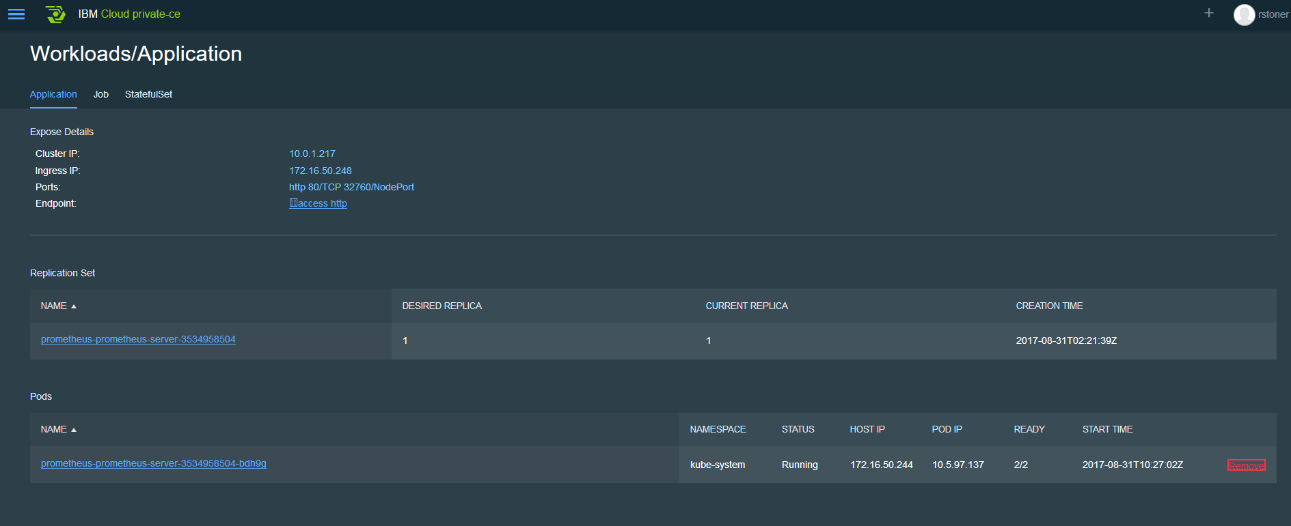
Prometheus Demo
Launch the Server UI by clicking on the endpoint

Slide 45
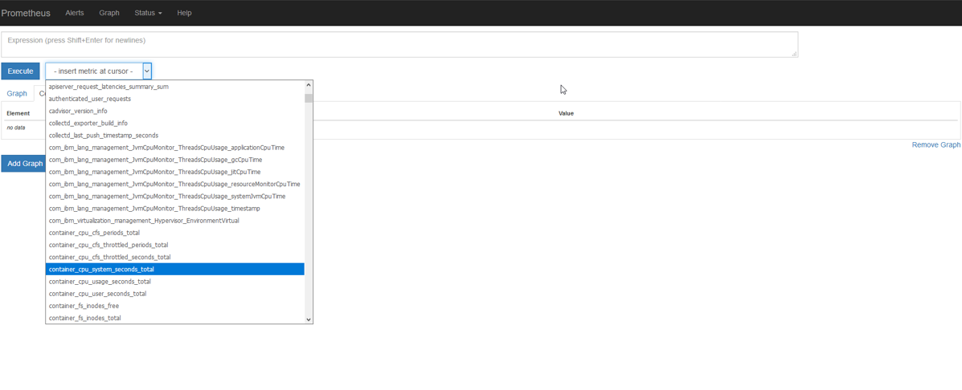
Prometheus Demo
Perform a query against the time series data, using the dropdown select the metric you would like to query, this example is using container_cpu_system_seconds total. Once the metric is selected, click on Execute to run the Query. You may also perform custom queries using the Expression area at the top of the screen.

Slide 46
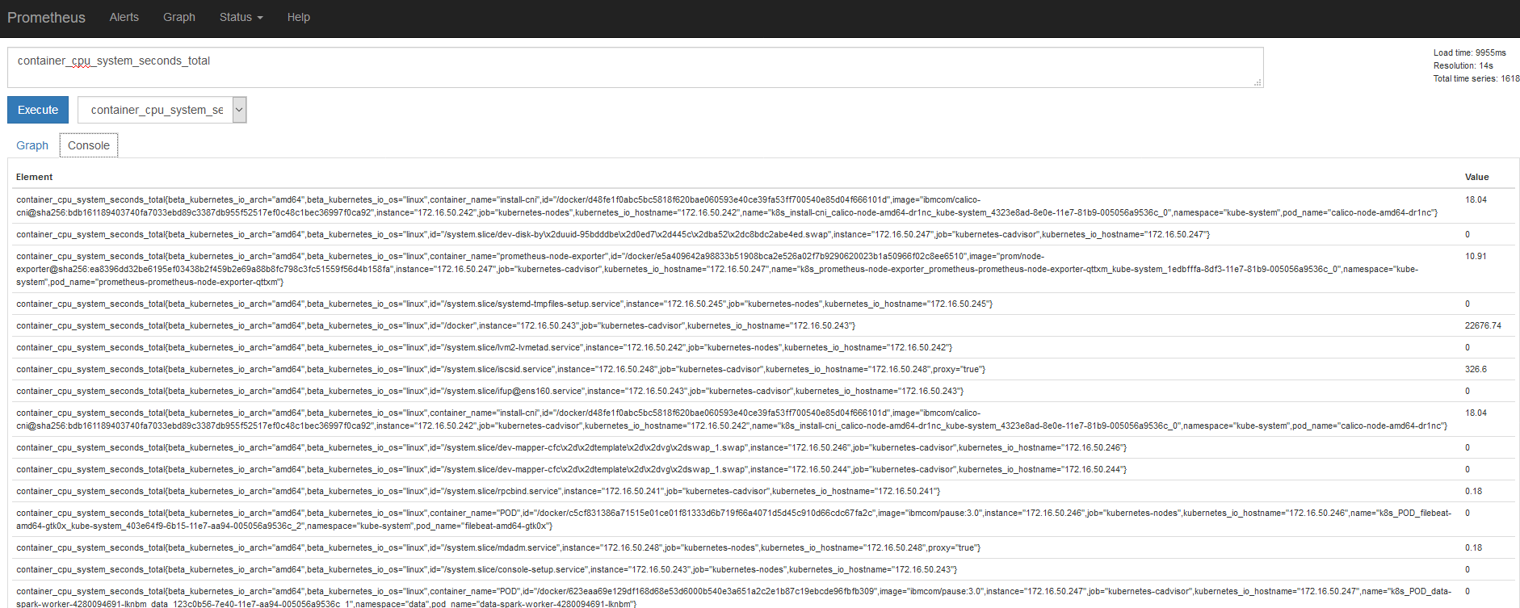
Prometheus Demo
The query results are then displayed on your console view:

Slide 47
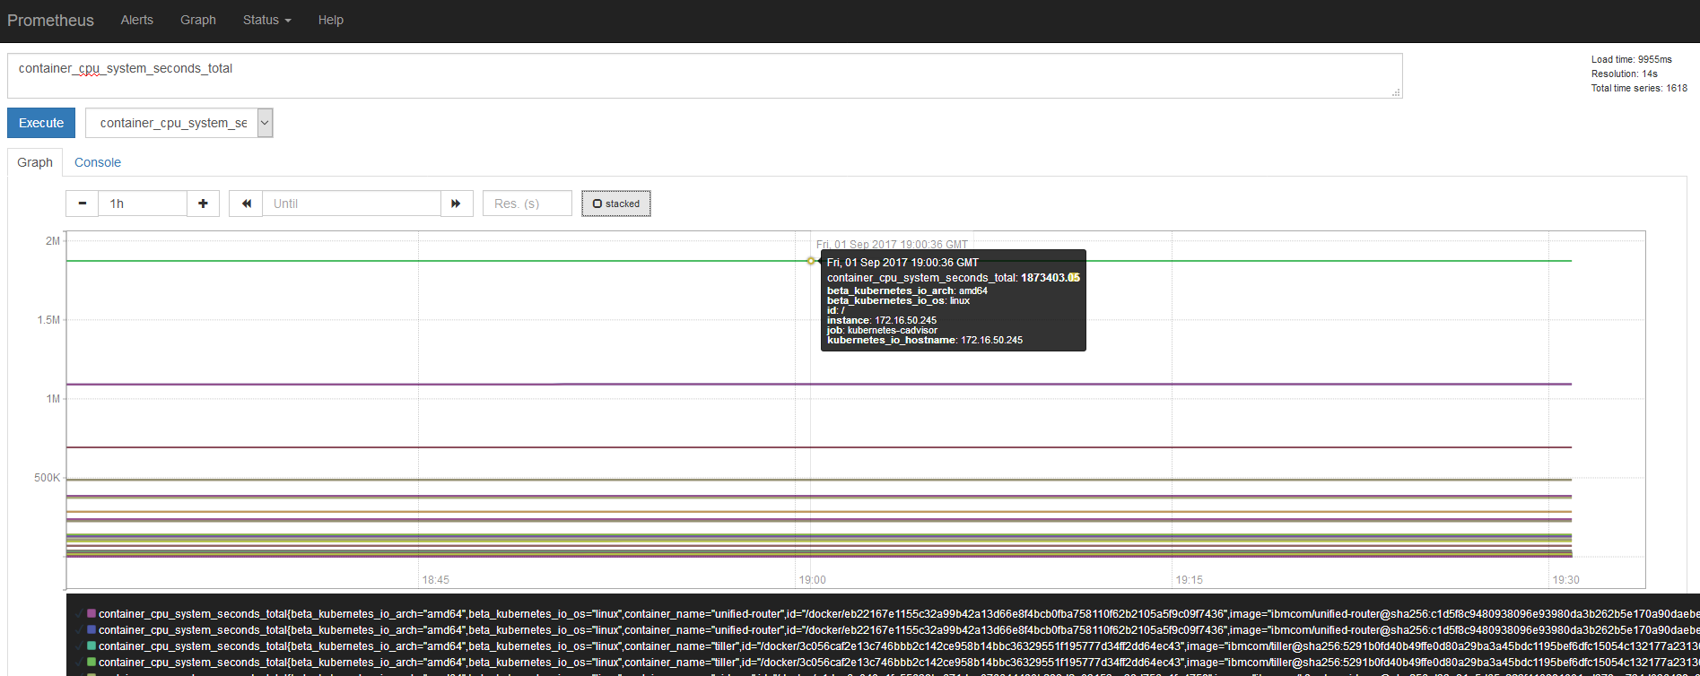
Prometheus Demo
Click the Graph button to graph the total cpu seconds:

Slide 48
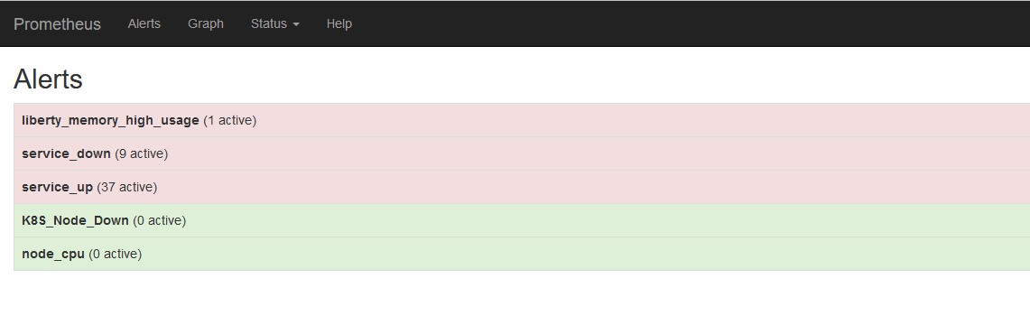
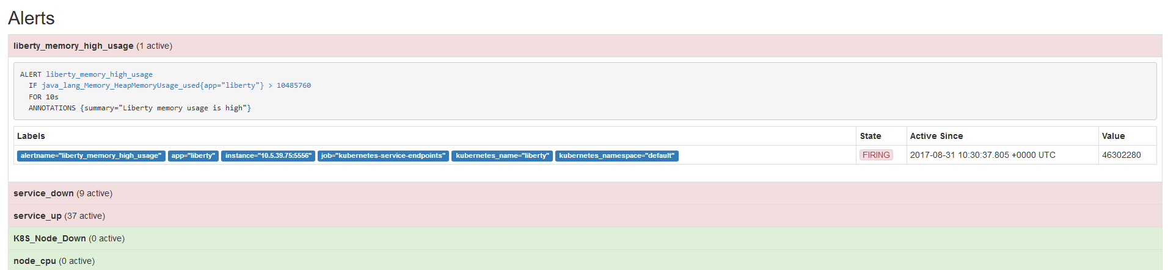
Prometheus Demo
There is an Alert summary view which displays a high level summary of open alerts:
Click on the alert group to see more information

Slide 49
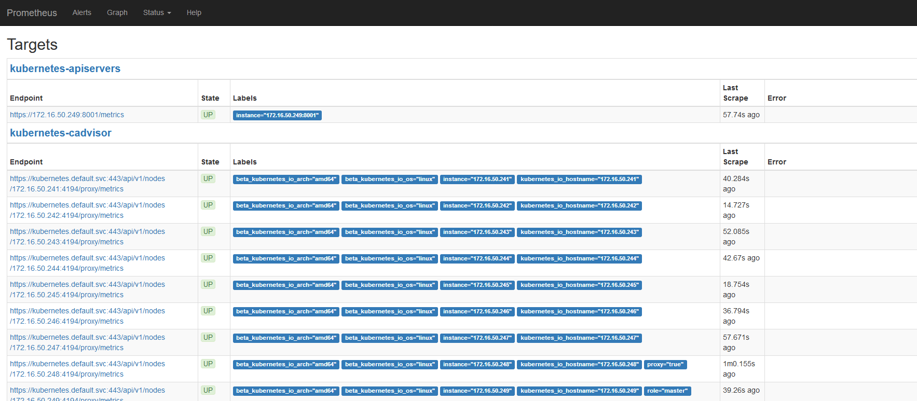
Prometheus Demo
A useful status is the Targets view, where you can see all the items that Prometheus is monitoring:

Slide 50
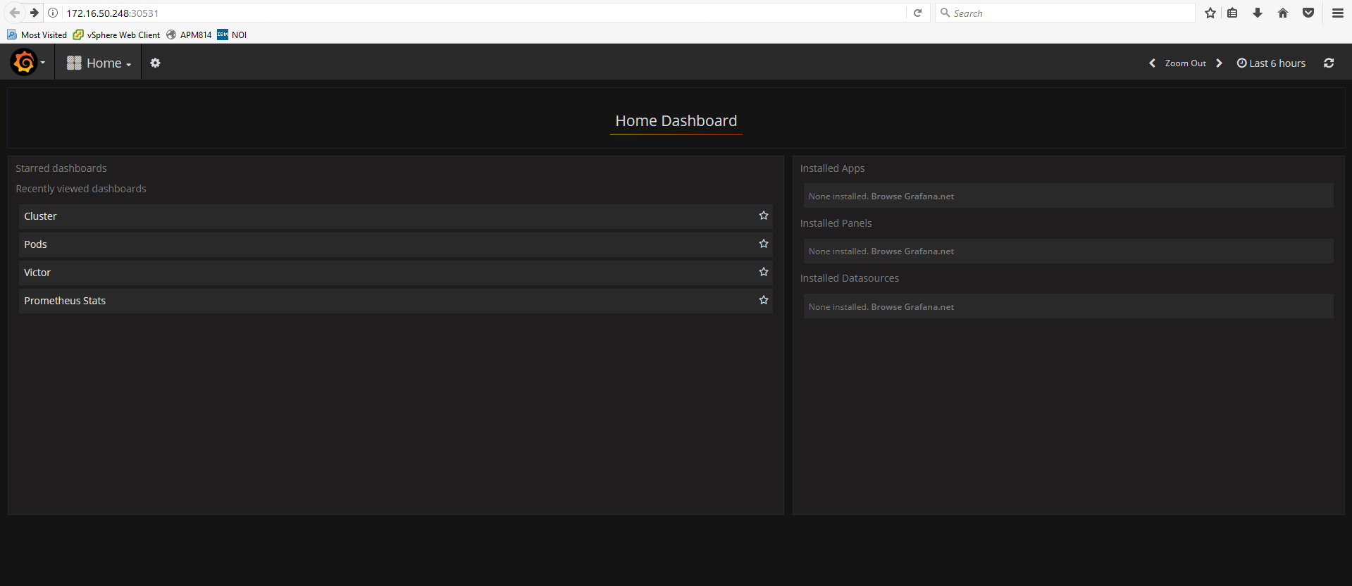
Grafana Demo
Grafana – Using Grafana provides to ability to view and leverage the data collected by Prometheus.

Slide 51
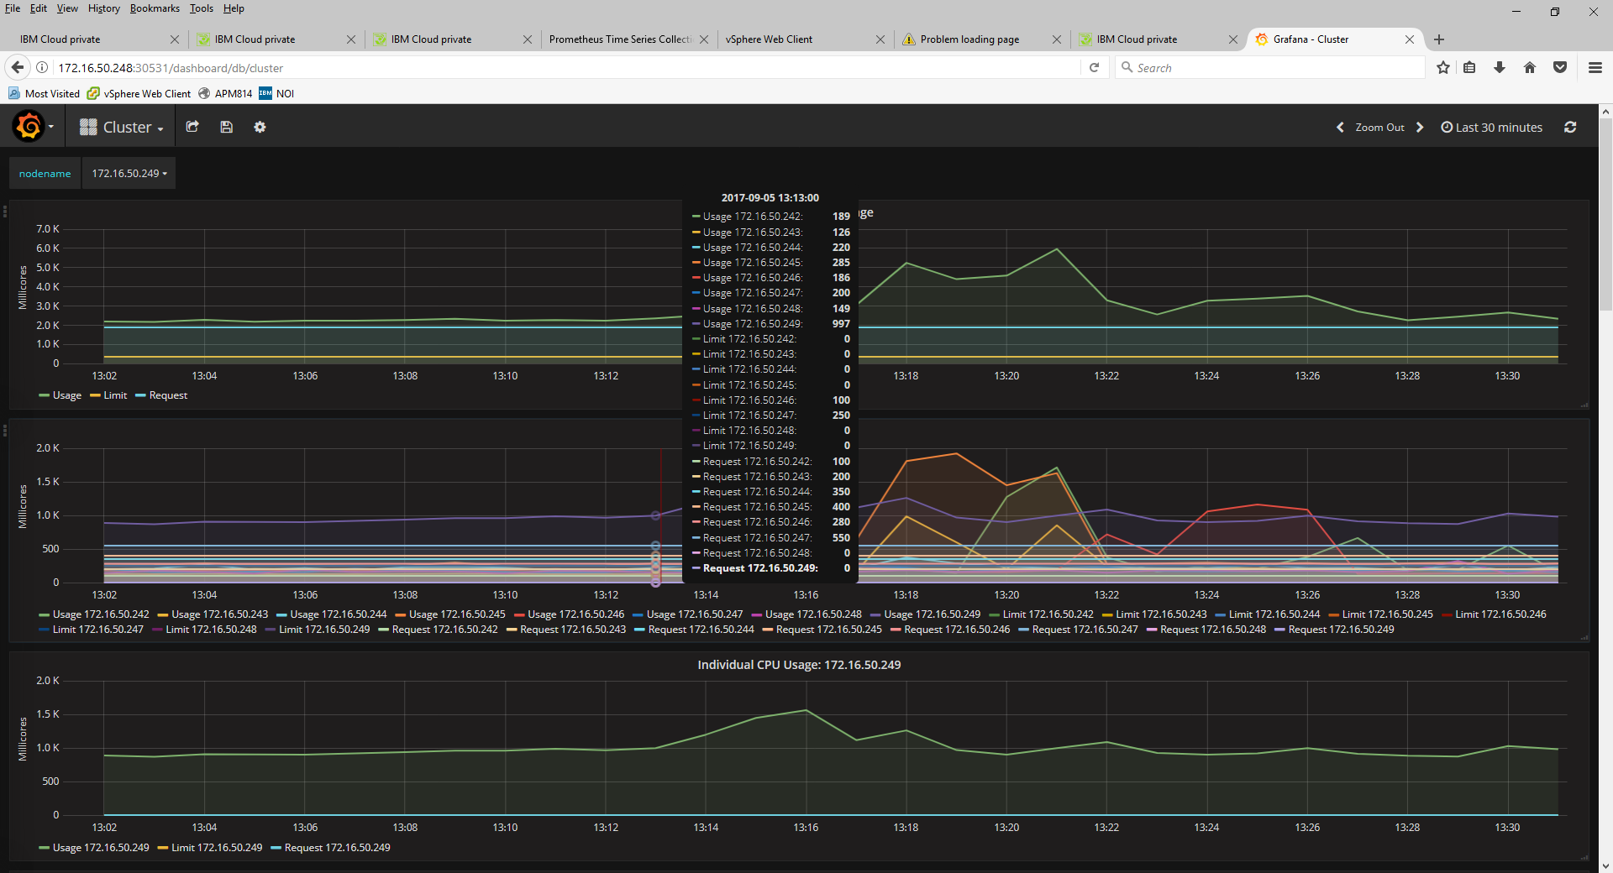
Grafana Demo
Below is the cluster view of the ICP deployment

Slide 52
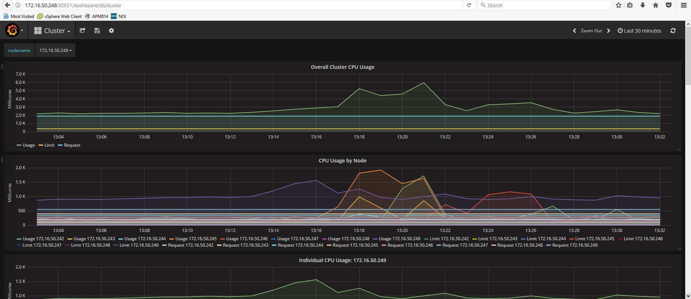
Grafana Demo
Below is the cluster view of the ICP deployment

Slide 53
Grafana Demo
Using your mouse to scroll over a view - a legend is provided with the cluster IP address an the metric value
Notes:
This top level view is quite “lengthy” be sure to scroll down to display the remaining metrics

Slide 54
Custom Dashboards with Grafana
Victor who is our Site Reliability Engineer for CAMSE has built a custom dashboard for the ICP workload.

Slide 55
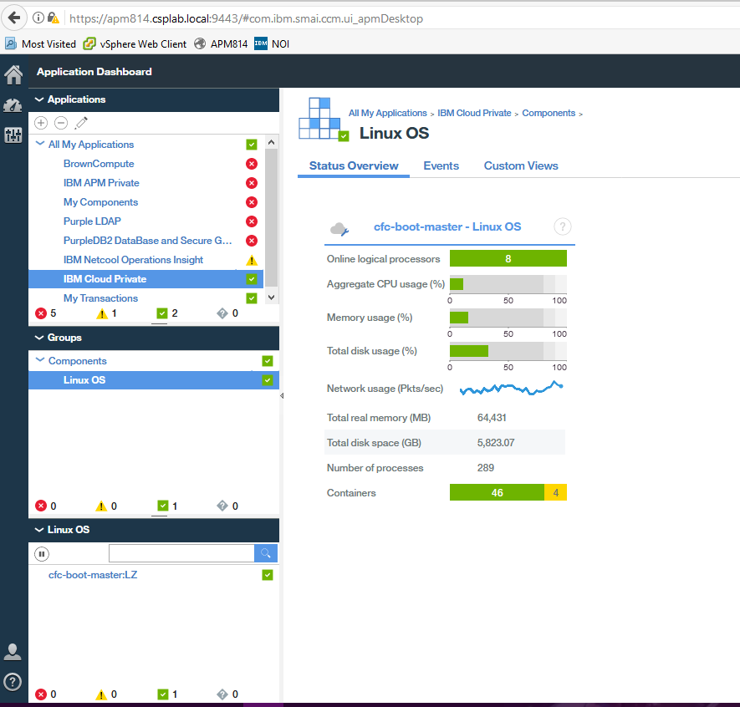
IBM Cloud private Performance Monitoring
Using IBMs APM to solution monitor resources in Icp
Existing IBM APM v8 customer can leverage the OS agent to monitor resource consumption of the ICP deployment.
No special configuration is required other then deploying ICP in an OS which is also supported by the OS Agent.
On the right is a high level summary view
of the OS agent

Slide 56
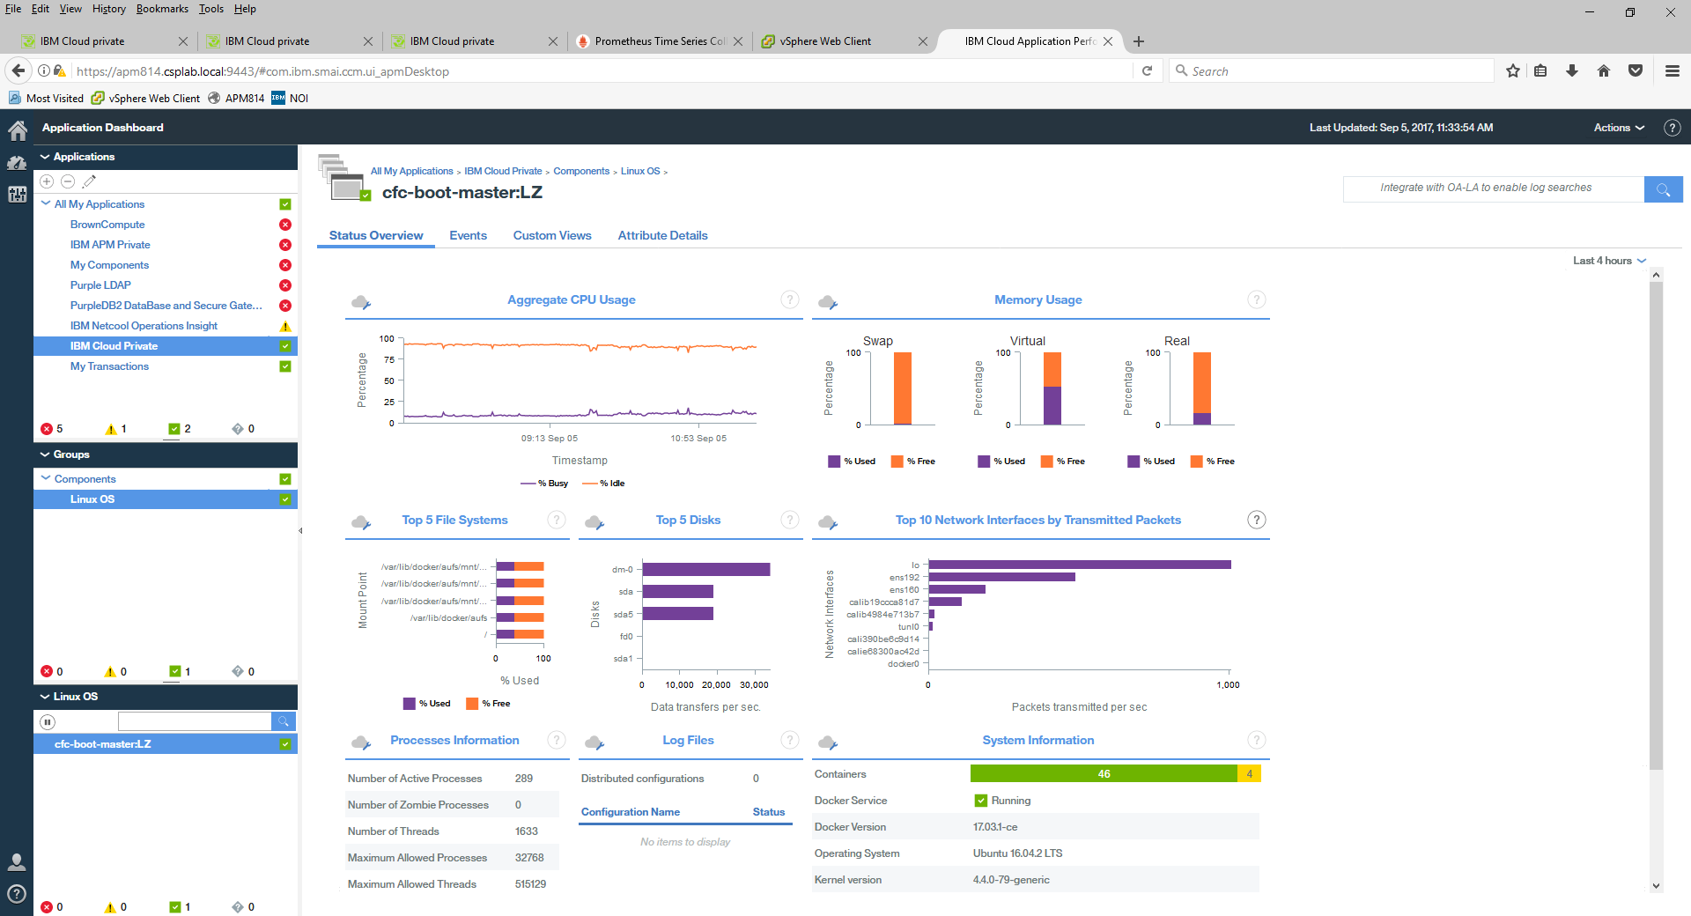
IBM Cloud private Performance Monitoring
Drill down into to OS agent, click anywhere within the status view, the lower right displays a summary of the containers running in the OS

Slide 57
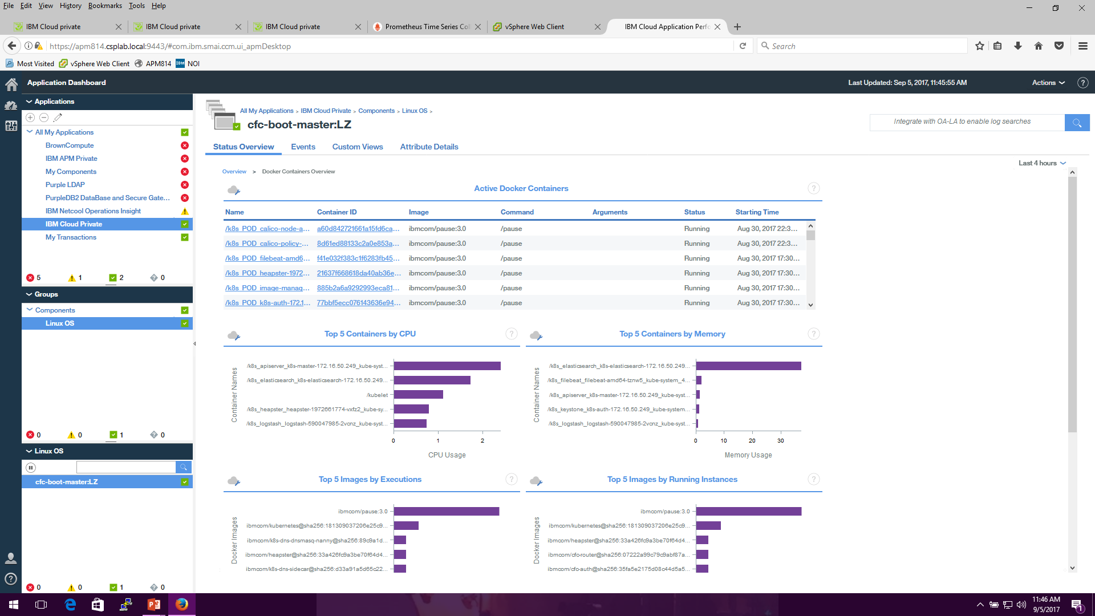
IBM Cloud private Performance Monitoring
Drill down into to a summary view of the containers , click anywhere within the System Information view
Notes:
Active Container View is sortabale by container id, command etc.

Slide 58
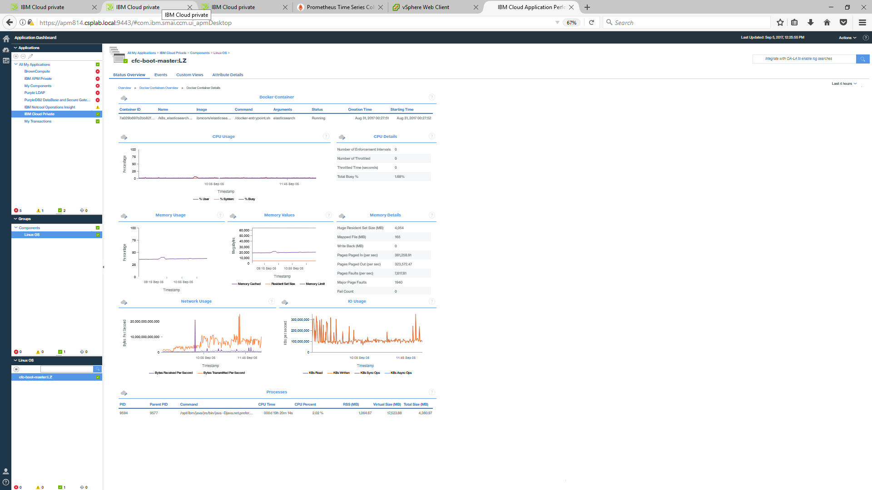
IBM Cloud private Performance Monitoring
Drill down to an individual container by clicking on the container in the active container view
Notes:
Here is view of the

Slide 59
This presentation is intended for an IBM internal audience only.

Slide 60
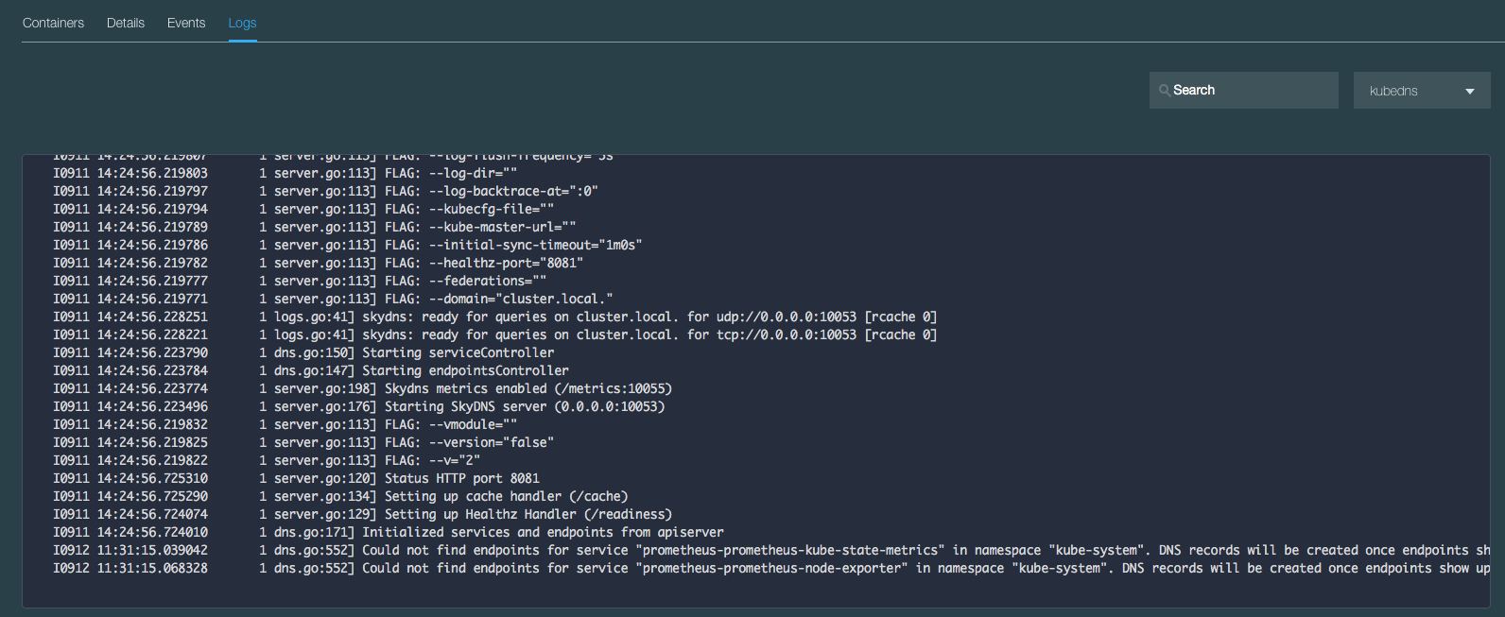
View Logs in Server UI
Example of looking at kube-dns logs:
In Server UI: Workloads → Applications
Select the application (eg. kube-dns) entry
In the lower section of the page
Select the application pod in the pod section
Scroll down and select the ‘Logs’ option

Slide 61

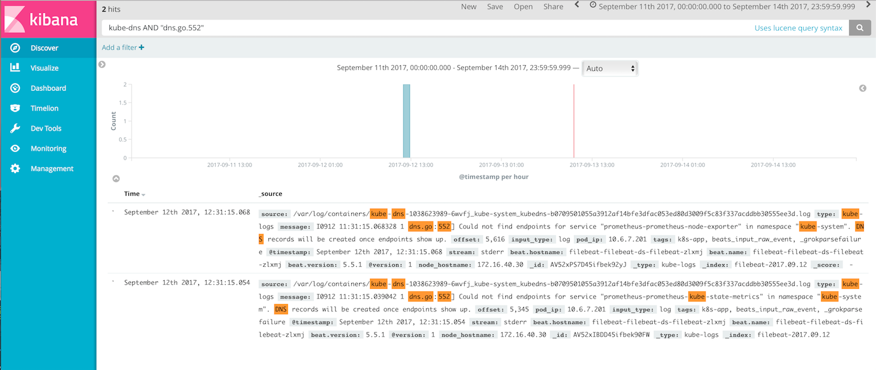
View Logs in Kibana
Use search filters to show log example entries shown in previous slide

